Slide 1

PSNZ Room Booking System
Project 1
NURIZAZI BINTI ZULKIFLI S61981

Slide 2

SUMMARY
- intuitive design for easy navigation
- Ability to reserve rooms for specific time slots, accommodating varying durations.
- Options to cancel or extend reservations based on user needs
- Quick booking procedure make the library experience better
- Seamless booking process with a calendar view of available slots.
- Accessible from various devices, including computers, tablets and smartphones

Slide 3
LESSON LEARNED
- Scaffold: implements the basic Material Design visual layout structure
- AppBar: Container that displays content and actions at the top of a screen
- Image Asset: image that obtaines from an asset bundle.
- use the boxDecoration to make the full screen image
- TextField: use the controller , to control the text that is displayed in the text field.
- ListTile: contains one or three lines of text optionally followed by radio widgets to choose a room.
- showDialog: display a material dialog above the current contents of the app
- $: to display the output

Slide 4
CONCLUSION
- Real time availability updates and empowering users to make educated booking decisions
- engaging user experience system across range of devices , responsive design concepts are applied
- solves the pressing need for a quick and easy way to reserve a space
- ensuring that the system continues to be effective in serving the needs of both library personnel and staff members

Slide 5
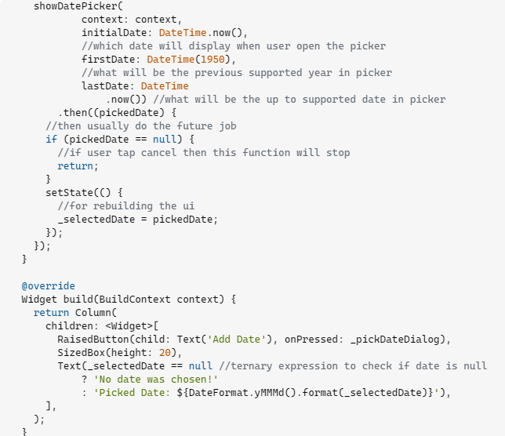
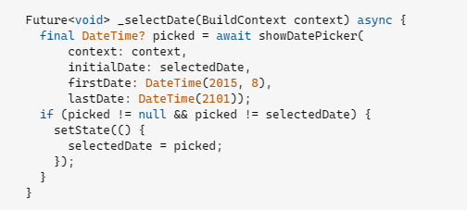
REFERENCE
Date Picker Function:
https://stackoverflow.com/questions/5272

Slide 6
THANK YOU
PREPARE FOR: DR MOHAMAD NOR

